Slide 1



................................................Housing Project…………………..………………………….
Submitted by: Jyoti Chaudhary
Name of the project: Housing Project

Slide 2



ACKNOWLEDGMENT
These resources that helped me and guided me in completion of the project

Slide 3

Introduction
Business Problem Framing (1)
Houses are one of the necessary need of each and every person around the globe and therefore housing and real estate market is one of the markets which is one of the major contributors in the world’s economy. It is a very large market and there are various companies working in the domain.

Slide 4
Business Problem Framing (page-2)
Data science comes as a very important tool to solve problems in
the domain to help the companies increase their overall revenue, profits, improving their marketing strategies and focusing on changing trends in
house sales and purchases.

Slide 5
Conceptual Background of the Domain Problem
We have used these methods for better understanding the project.
Correlation method to understand relationships between the feature how much they correlate with other.
We have used “ Lineplot , Distplot,Scatterplot”, Visualizing the relationship between SalePrice and YearBuilt.
Visualizing the relationship between Sale prices and Overall Quality
Visulizing the Distribution of SalePrice
Visualizing the relationship between SalePrice and SaleType

Slide 6

Statistical / Analytical Modeling of the Problem.PAGE(1)
#First of all we have loaded our dataset:
Code: train=pd.read_csv("train.csv.xlsx")
test=pd.read_csv("test.csv.xlsx")
#We have used to describe our dataset
Code: train.describe()
test.describe()
#checking data:
Code: train.dtypes
#To Checking shape:
Code: train.shape
And we have found many null values in the dataset.
.Plot missing values
. Fixing the missing data
CODE: fill_missing_values(train)
train.isnull().sum().max()
After fixing the missing values we will chec k it:
#check null values in the dataframe:
CODE: train.isnull()

Slide 7
Statistical / Analytical Modeling of the Problem.PAGE(2)
#We have used correlation method to checking correlation.
Code: corr_mat = train.corr()
- > we have found this observation of correlation:
->We can see that the features OverallQual, GarageArea and YearBuilt are closely correlated with the sale price.
#checking skewness:
To Remove Skewness we used PowerTransformer() This will convert the numpy array in PowerTrnasform :
#convert the transform value into the dataset,we will get the values in the form of x.
#After the transformer (Now It contained the transformed value)
x=pd.DataFrame (x_new)

Slide 8

Statistical / Analytical Modeling of the Problem.PAGE(3)
#After the transformation we validated that skewness has removed or not?
CODE:
x=pd.DataFrame (x_new)
x.skew().sort_values(ascending=False)
…………………………………………………………………………………..
………. OUTLIERS…..
CODE:
x.iloc[:,0:30].boxplot(figsize=[20,8])
plt.subplots_adjust(bottom=0.25)
plt.show()

Slide 9

Let’s Quantify:
CODE: from scipy.stats import zscore
(np.abs(zscore(x))).all().all()
CODE: (np.abs(zscore(x))<3).all().all()
Normalizing/Scalling the data
## normalizing/Scalling the data ​from sklearn.preprocessing import MinMaxScalerscaler = MinMaxScaler()
#scaler.fit(X)
#X = scaler.transform(X)
#X = pd.DataFrame(X)
#checking upper 2 rows:
x.head(2)

Slide 10
Analytical Problem Framing
Data Exploration,Handle Missing values
Plot missing values
We have used for Analysing the dataset:
.Lineplot
.Distplot
Catplot
Scatterplot
………………………………………………………………………………
FIND BEST RANDOM STATE:
from sklearn.linear_model import LogisticRegression
from sklearn.tree import DecisionTreeClassifier
from sklearn.metrics import accuracy_score
from sklearn.metrics import confusion_matrix,classification_report
from sklearn.model_selection import train_test_split

Slide 11

Best Random State:
maxAccu=0
maxRS=0
for i in range(1,200):
x_train,x_test,y_train,y_test=train_test_split(x,y,test_size=.20,random_state=1)
lr=LogisticRegression()
lr.fit(x_train,y_train)
#fitting the data will train your model
predlr=lr.predict(x_test)
#this is the predicted targetv v ariable
acc=accuracy_score(y_test,predlr)
#accurac y_score
print('testing accuracy',acc,"random_state",i)
if acc>maxAccu:
maxAccu=acc
maxRS=i
print('max_accuracy',maxAccu,'max_random_state',i)
CREATING TRAIN_TEST_SPLIT:
x_train,x_test,y_train,y_test=train_test_split(x,y,test_size=.20,random_state=199)
#check the shape of train and test
x_train.shape
x_test.shape
y_train.shape
y_test.shape

Slide 12
Modelling:
……………….Ensemble Models………………
#from sklearn.metrics import confusion_matrix, roc_curve, roc_auc_score, accuracy_score, precision_recall_curve
from sklearn.metrics import confusion_matrix,classification_report,f1_score, precision_score, recall_score, roc_curve, auc, average_precision_score, roc_auc_score, accuracy_score, precision_recall_curve, f1_score
from sklearn.linear_model import LogisticRegression
from sklearn.neighbors import KNeighborsClassifier
from sklearn.naive_bayes import GaussianNB
from sklearn import model_selection
from sklearn.model_selection import cross_val_score, GridSearchCV
from sklearn.model_selection import KFold
from sklearn.svm import SVC
from sklearn.ensemble import RandomForestClassifier
Cross validation
#CROSS VALIDATION:from sklearn.model_selection import cross_val_score#validation
accuracycr_1=cross_val_score(lr,x,y,cv=5)print("Cross Validation Score of LogisticRegression
model :",cr_1.mean())
.

Slide 13

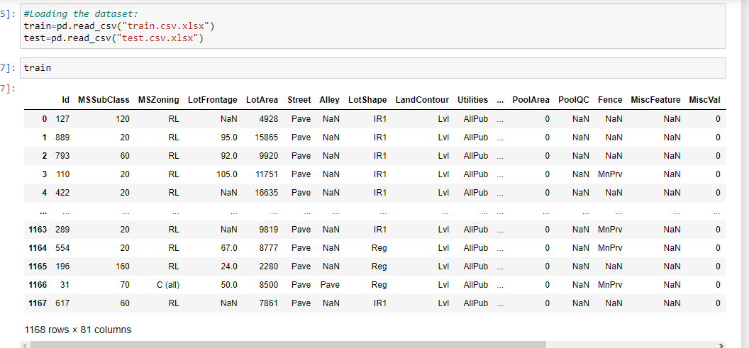
Data description

Slide 14
Description
• Data contains 1460 entries each having 81 variables.
Attributes: MSSubClass: Identifies the type of dwelling involved in the sale.
20 1-STORY 1946 & NEWER ALL STYLES
30 1-STORY 1945 & OLDER
40 1-STORY W/FINISHED ATTIC ALL AGES
45 1-1/2 STORY - UNFINISHED ALL AGES
50 1-1/2 STORY FINISHED ALL AGES
60 2-STORY 1946 & NEWER
70 2-STORY 1945 & OLDER
75 2-1/2 STORY ALL AGES
80 SPLIT OR MULTI-LEVEL
85 SPLIT FOYER
90 DUPLEX - ALL STYLES AND AGES
120 1-STORY PUD (Planned Unit Development) - 1946 & NEWER
150 1-1/2 STORY PUD - ALL AGES
160 2-STORY PUD - 1946 & NEWER
180 PUD - MULTILEVEL - INCL SPLIT LEV/FOYER
190 2 FAMILY CONVERSION - ALL STYLES AND AGES
MSZoning: Identifies the general zoning classification of the sale.
A Agriculture
C Commercial
FV Floating Village Residential
I Industrial
RH Residential High Density
RL Residential Low Density
RP Residential Low Density Park
RM Residential Medium Density

Slide 15
Attributes:
LotFrontage: Linear feet of street connected to property
LotArea: Lot size in square feet
Street: Type of road access to property
Grvl Gravel
Pave Paved
Alley: Type of alley access to property
Grvl Gravel
Pave Paved
NA No alley access
LotShape: General shape of property
Reg Regular
IR1 Slightly irregular
IR2 Moderately Irregular
IR3 Irregular
LandContour: Flatness of the property
Lvl Near Flat/Level
Bnk Banked - Quick and significant rise from street grade to building
HLS Hillside - Significant slope from side to side
Low Depression

Slide 16
Attributes
Utilities: Type of utilities available
AllPub All public Utilities (E,G,W,& S)
NoSewr Electricity, Gas, and Water (Septic Tank)
NoSeWa Electricity and Gas Only
ELO Electricity only
LotConfig: Lot configuration
Inside Inside lot
Corner Corner lot
CulDSac Cul-de-sac
FR2 Frontage on 2 sides of property
FR3 Frontage on 3 sides of property
LandSlope: Slope of property
Gtl Gentle slope
Mod Moderate Slope
Sev Severe Slope

Slide 17
Attributes:
Neighborhood: Physical locations within Ames city limits
Blmngtn Bloomington Heights
Blueste Bluestem
BrDale Briardale
BrkSide Brookside
ClearCr Clear Creek
CollgCr College Creek
Crawfor Crawford
Edwards Edwards
Gilbert Gilbert
IDOTRR Iowa DOT and Rail Road
MeadowV Meadow Village
Mitchel Mitchell
Names North Ames
NoRidge Northridge
NPkVill Northpark Villa
NridgHt Northridge Heights
NWAmes Northwest Ames
OldTown Old Town
SWISU South & West of Iowa State University
Sawyer Sawyer
SawyerW Sawyer West
Somerst Somerset
StoneBr Stone Brook
Timber Timberland
Veenker Veenker

Slide 18
Atrributes:
Condition1: Proximity to various conditions
Artery Adjacent to arterial street
Feedr Adjacent to feeder street
Norm Normal
RRNn Within 200' of North-South Railroad
RRAn Adjacent to North-South Railroad
PosN Near positive off-site feature--park, greenbelt, etc.
PosA Adjacent to postive off-site feature
RRNe Within 200' of East-West Railroad
RRAe Adjacent to East-West Railroad
Condition2: Proximity to various conditions (if more than one is present)
Artery Adjacent to arterial street
Feedr Adjacent to feeder street
Norm Normal
RRNn Within 200' of North-South Railroad
RRAn Adjacent to North-South Railroad
PosN Near positive off-site feature--park, greenbelt, etc.
PosA Adjacent to postive off-site feature
RRNe Within 200' of East-West Railroad
RRAe Adjacent to East-West Railroad

Slide 19
Attributes:
BldgType: Type of dwelling
1Fam Single-family Detached
2FmCon Two-family Conversion; originally built as one-family dwelling
Duplx Duplex
TwnhsE Townhouse End Unit
TwnhsI Townhouse Inside Unit
HouseStyle: Style of dwelling
1Story One story
1.5Fin One and one-half story: 2nd level finished
1.5Unf One and one-half story: 2nd level unfinished
2Story Two story
2.5Fin Two and one-half story: 2nd level finished
2.5Unf Two and one-half story: 2nd level unfinished
SFoyer Split Foyer
SLvl Split Level

Slide 20

Attributes:
OverallQual : Rates the overall material and finish of the house
10 Very Excellent
9 Excellent
8 Very Good
7 Good
6 Above Average
5 Average
4 Below Average
3 Fair
2 Poor
1 Very Poor
OverallCond : Rates the overall condition of the house
10 Very Excellent
9 Excellent
8 Very Good
7 Good
6 Above Average
5 Average
4 Below Average
3 Fair
2 Poor
1 Very Poor
YearBuilt : Original construction date

Slide 21
Attributes
YearRemodAdd : Remodel date (same as construction date if no remodeling or additions)
RoofStyle: Type of roof
Flat Flat
Gable Gable
Gambrel Gabrel (Barn)
Hip Hip
Mansard Mansard
Shed Shed
RoofMatl: Roof material
ClyTile Clay or Tile
CompShg Standard (Composite) Shingle
Membran Membrane
Metal Metal
Roll Roll
Tar&Grv Gravel & Tar
WdShake Wood Shakes
WdShngl Wood Shingles

Slide 22
ATTRIBUTES:
MasVnrType: Masonry veneer type
BrkCmn Brick Common
BrkFace Brick Face
CBlock Cinder Block
None None
Stone Stone
MasVnrArea: Masonry veneer area in square feet
ExterQual: Evaluates the quality of the material on the exterior
Ex Excellent
Gd Good
TA Average/Typical
Fa Fair
Po Poor
ExterCond: Evaluates the present condition of the material on the exterior
Ex Excellent
Gd Good
TA Average/Typical
Fa Fair
Po Poor

Slide 23
Attributes:
Foundation: Type of foundation
BrkTil Brick & Tile
CBlock Cinder Block
PConc Poured Contrete
Slab Slab
Stone Stone
Wood Wood
BsmtQual: Evaluates the height of the basement
Ex Excellent (100+ inches)
Gd Good (90-99 inches)
TA Typical (80-89 inches)
Fa Fair (70-79 inches)
Po Poor (<70 inches
NA No Basement
BsmtCond: Evaluates the general condition of the basement
Ex Excellent
Gd Good
TA Typical - slight dampness allowed
Fa Fair - dampness or some cracking or settling
Po Poor - Severe cracking, settling, or wetness
NA No Basement

Slide 24

Attributes:
BsmtExposure: Refers to walkout or garden level walls
Gd Good Exposure
Av Average Exposure (split levels or foyers typically score average or above)
Mn Mimimum Exposure
GLQ Good Living Quarters
ALQ Average Living Quarters
BLQ Below Average Living Quarters
Rec Average Rec Room
LwQ Low Quality
Unf Unfinshed
NA No Basement
BsmtFinSF2: Type 2 finished square feet
BsmtUnfSF: Unfinished square feet of basement area
TotalBsmtSF: Total square feet of basement area
BsmtFinType2: Rating of basement finished area (if multiple types)
No No Exposure
NA No Basement
BsmtFinType1: Rating of basement finished area
GLQ Good Living Quarters
ALQ Average Living Quarters
BLQ Below Average Living Quarters
Rec Average Rec Room
LwQ Low Quality
Unf Unfinshed
NA No Basement
BsmtFinSF1: Type 1 finished square feet

Slide 25
Attributes:
Heating: Type of heating
Floor Floor Furnace
GasA Gas forced warm air furnace
GasW Gas hot water or steam heat
Grav Gravity furnace
OthW Hot water or steam heat other than gas
Wall Wall furnace
HeatingQC: Heating quality and condition
Ex Excellent
Gd Good
TA Average/Typical
Fa Fair
Po Poor
CentralAir: Central air conditioning
N No
Y Yes
Electrical: Electrical system
SBrkr Standard Circuit Breakers & Romex
FuseA Fuse Box over 60 AMP and all Romex wiring (Average)
FuseF 60 AMP Fuse Box and mostly Romex wiring (Fair)
FuseP 60 AMP Fuse Box and mostly knob & tube wiring (poor)
Mix Mixed

Slide 26
Attributes:
1stFlrSF: First Floor square feet
2ndFlrSF: Second floor square feet
LowQualFinSF: Low quality finished square feet (all floors)
GrLivArea: Above grade (ground) living area square feet
BsmtFullBath: Basement full bathrooms
BsmtHalfBath: Basement half bathrooms
FullBath: Full bathrooms above grade
HalfBath: Half baths above grade
Bedroom: Bedrooms above grade (does NOT include basement bedrooms)
Kitchen: Kitchens above grade

Slide 27
Attributes:
KitchenQual : Kitchen quality
Ex Excellent
Gd Good
TA Typical/Average
Fa Fair
Po Poor
TotRmsAbvGrd : Total rooms above grade (does not include bathrooms)
Functional : Home functionality (Assume typical unless deductions are warranted)
Typ Typical Functionality
Min1 Minor Deductions 1
Min2 Minor Deductions 2
Mod Moderate Deductions
Maj1 Major Deductions 1
Maj2 Major Deductions 2
Sev Severely Damaged
Sal Salvage only

Slide 28
Attributes:
Fireplaces: Number of fireplaces
FireplaceQu: Fireplace quality
Ex Excellent - Exceptional Masonry Fireplace
Gd Good - Masonry Fireplace in main level
TA Average - Prefabricated Fireplace in main living area or Masonry Fireplace in basement
Fa Fair - Prefabricated Fireplace in basement
Po Poor - Ben Franklin Stove
NA No Fireplace
GarageType: Garage location
2Types More than one type of garage
Attchd Attached to home
Basment Basement Garage
BuiltIn Built-In (Garage part of house - typically has room above garage)
CarPort Car Port
Detchd Detached from home
NA No Garage
GarageYrBlt: Year garage was built
GarageFinish: Interior finish of the garage
Fin Finished
RFn Rough Finished
Unf Unfinished
NA No Garage

Slide 29
Atrributes:
GarageCars: Size of garage in car capacity
GarageArea: Size of garage in square feet
GarageQual: Garage quality
Ex Excellent
Gd Good
TA Typical/Average
Fa Fair
Po Poor
NA No Garage
GarageCond: Garage condition
Ex Excellent
Gd Good
TA Typical/Average
Fa Fair
Po Poor
NA No Garage

Slide 30
Attributes:
PavedDrive: Paved driveway
Y Paved
P Partial Pavement
N Dirt/Gravel
WoodDeckSF: Wood deck area in square feet
OpenPorchSF: Open porch area in square feet
EnclosedPorch: Enclosed porch area in square feet
3SsnPorch: Three season porch area in square feet
ScreenPorch: Screen porch area in square feet
PoolArea: Pool area in square feet

Slide 31

Attributes:
PoolQC: Pool quality
ExExcellent
Gd Good
TA Average/Typical
FaFair
NA No Pool
Fence: Fence quality
GdPrv Good Privacy
MnPrv Minimum Privacy
GdWo Good Wood
MnWw Minimum Wood/Wire
NA No Fence

Slide 32
Attributes:
MiscFeature: Miscellaneous feature not covered in other categories
Elev Elevator
Gar2 2nd Garage (if not described in garage section)
Othr Other
Shed Shed (over 100 SF)
TenC Tennis Court
NA None
MiscVal: $Value of miscellaneous feature
MoSold: Month Sold (MM)
YrSold: Year Sold (YYYY)
SaleType: Type of sale
WD Warranty Deed - Conventional
CWD Warranty Deed - Cash
VWD Warranty Deed - VA Loan
New Home just constructed and sold
COD Court Officer Deed/Estate
Con Contract 15% Down payment regular terms
ConLw Contract Low Down payment and low interest
ConLI Contract Low Interest
ConLD Contract Low Down
Oth Other

Slide 33
Attributes:
SaleCondition: Condition of sale
Normal Normal Sale
Abnorml Abnormal Sale - trade, foreclosure, short sale
AdjLand Adjoining Land Purchase
Alloca Allocation - two linked properties with separate deeds, typically condo with a garage unit
Family Sale between family members
Partial Home was not completed when last assessed (associated with New Homes)0000000000000000000000

Slide 34
Data Preprocessing Done:
x=train.drop("SalePrice",axis=1)
y=train["SalePrice"]
# Use train_test_split from sci-kit learn to segment our data into train and test
x_train, x_test, y_train, y_test = train_test_split(x, y, test_size=0.20)

Slide 35
Tools Used:
# Import Sci-Kit Learn
from sklearn.preprocessing import LabelEncoder
from sklearn.preprocessing import Normalizer
from sklearn.linear_model import LinearRegression,
from sklearn.svm import SVR
from sklearn.model_selection import train_test_split
from sklearn.model_selection import cross_val_score
For plotting missing values.
-> pip install missingno
Import numpy as np # linear algebra
For Loading the dataset:
import pandas as pd # data processing, CSV file I/O (e.g. pd.read_csv)
pd.set_option('display.width', 1000)
# Plotting Tools
With matplotlib.pyplot(Plot missing values by count ),Plotting the figures.
import matplotlib.pyplot as plt
plt.style.use('ggplot')
import seaborn as sns

Slide 36
Statistical and analytical approaches for solving of this problem. (1)
…………………………………….
train.head()
train.dtypes()
train.shape()
train.info()
train.describe()
# find columns having missing values and count
search for missing data
Fixing the missing data
IMPUTING MISSING VALUES
Function to visualize missing values
Check null values in the dataframe
Checking Correlation
Visulaizing the relationship between SalePrice and YearBuilt
Lineplot
Visualizing the relationship between Sale prices and Overall Quality
.Lineplot
Visulizing the Distribution of SalePrice
Distplot
Visualizing the relationship between SalePrice and SaleType
Catplot

Slide 37
Statistical and analytical approaches for solving of this problem. (2)
Analysing
LabelEncoding()
Corr_matrix()
Preprocessing the data:
Checking Skweness and Removing skewness.
Checking Outliers and Removing Outliers.
Normalizing and Scalling the data.
Find Best Random State.
Creating train_test_split.
Modelling.
Predictions.
Saving the model.

Slide 38
. Listing down all the algorithms used for the training and testing.
from sklearn.model_selection import train_test_split
Use train_test_split from sci-kit learn to segment our data into train and a local testset
X_train, X_test, y_train, y_test = train_test_split(X, y, test_size=0.20)

Slide 39
Describe how the input affects the output. (1)
It affects the housing supply.
The primary factor influencing supply of housing is the price of housing. As price increases, the quantity supplied also increases. The supply of housing is shifted by changes in the price of inputs and changes in technology.

Slide 40
Most important factors that influence your home's value(2)
Neighbourhood comps
Location
Home size and usable space
Interest rates
Age and condition
Economic indicators
Upgrade and update
The Local market

Slide 41

Visualizations:

Slide 42
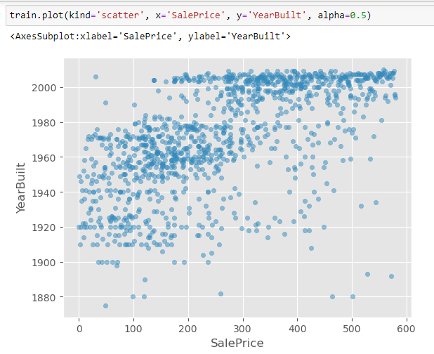
Scatterplot:

Slide 43
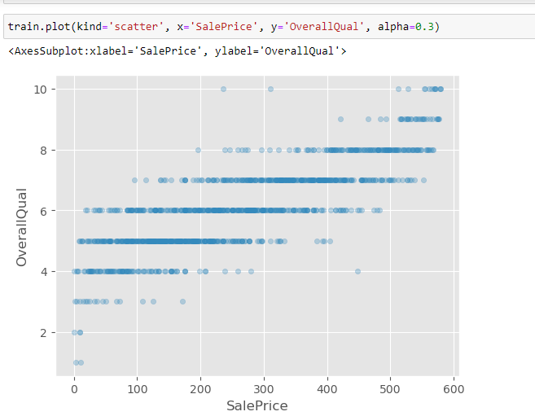
Scatterplot:

Slide 44
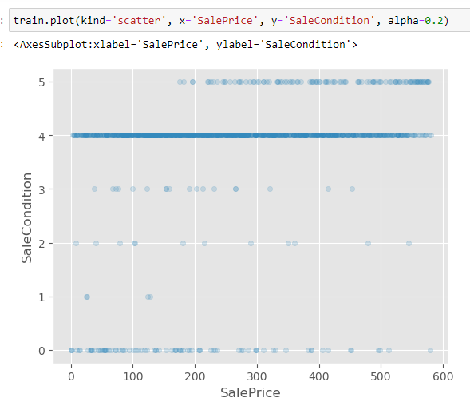
Scatterplot:

Slide 45
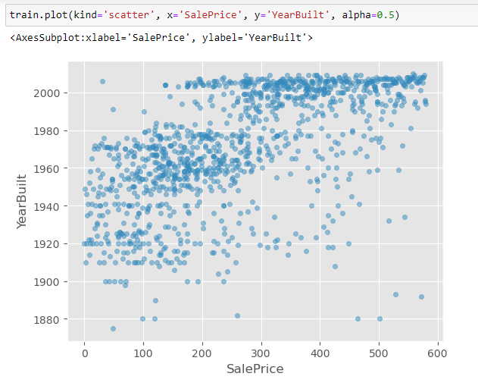
Scatterplot:

Slide 46
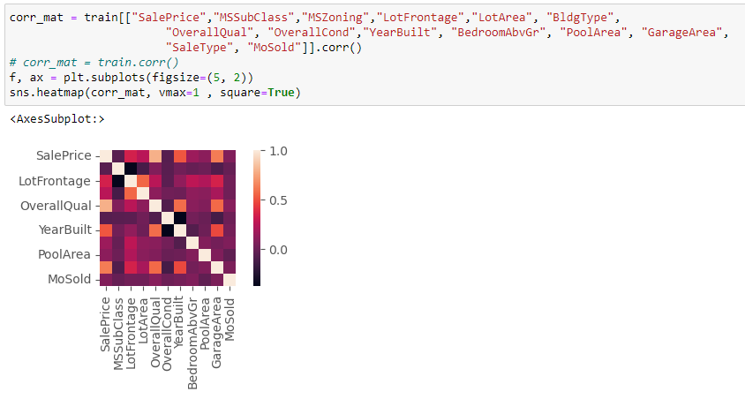
Visualization - -> Correlation:
We can see that the features OverallQual, GarageArea and YearBuilt are closely correlated with the sale price.
That means these features play an important role in determining the SalePrice of a house. Similarly a lot of
inferences can be made just by looking at the heatmap but we're not going to go through each one of them.
If you don't know what a heatmap is and wish to learn.

Slide 47
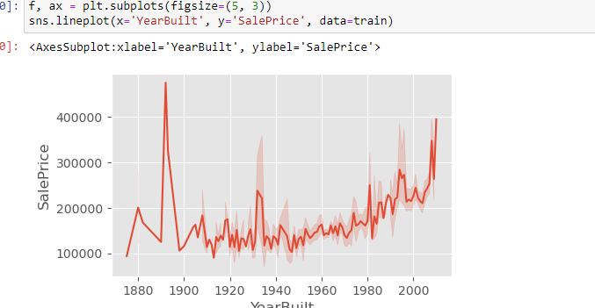
VISUALIZATION : Lineplot:
You might have noticed a significant increase in SalePrices just after the start of the 21st century,
which is pretty interesting. What's even more surprising is the late 1800s saw phenomenal increase in
SalePrices but dropping way below even before the end of that century.

Slide 48
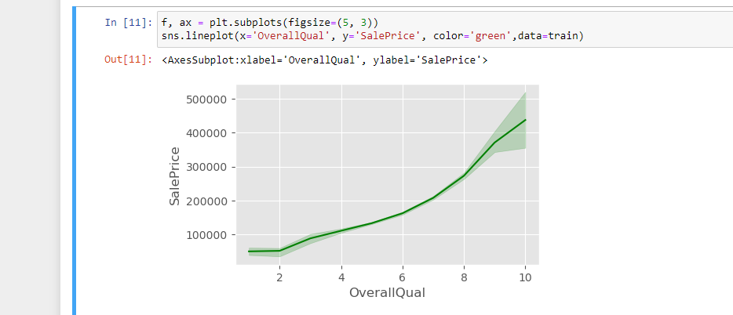

VISUALIZATION : Lineplot:
We can see that the SalePrices increase rapidly with houses with better overall quality which is pretty reasonable.

Slide 49
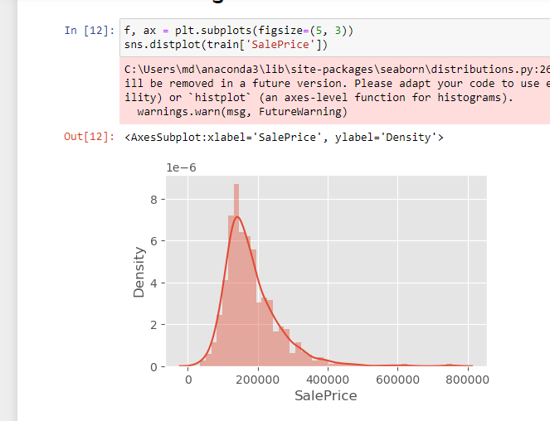

visualization Distplot:
It is clear that the selling prices for Sale types 2 and 6 are significantly higher than the others.

Slide 50
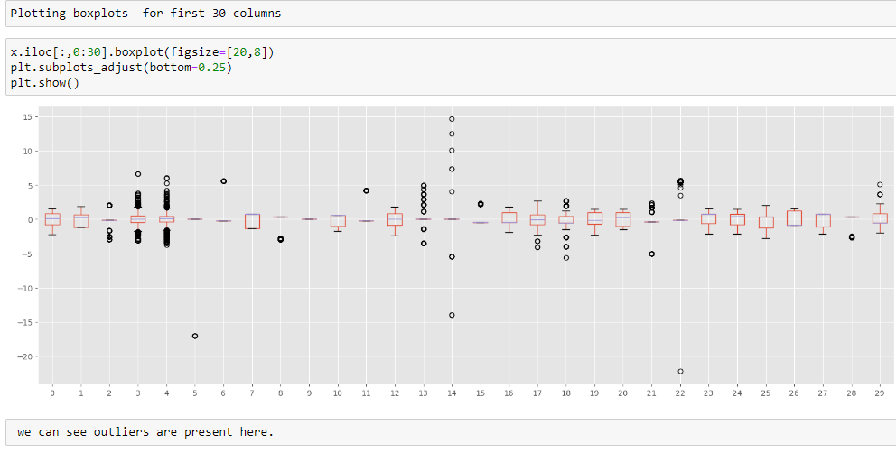
Outliers:

Slide 51
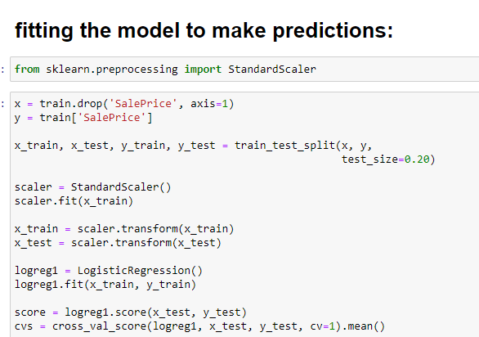
Modelling: Logistic Regression

Slide 52
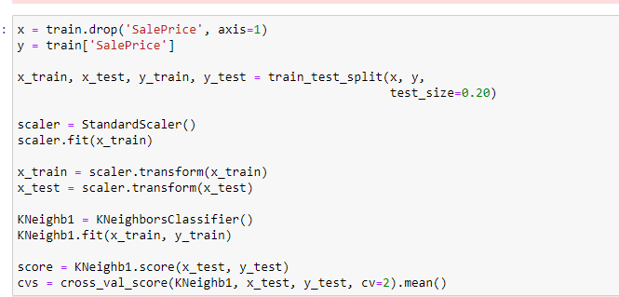
KNeighborsClassifier

Slide 53
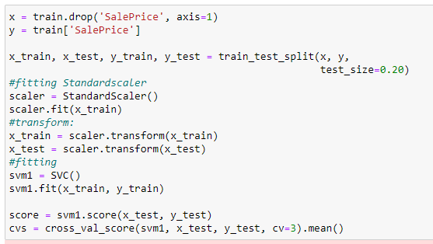
SVM

Slide 54
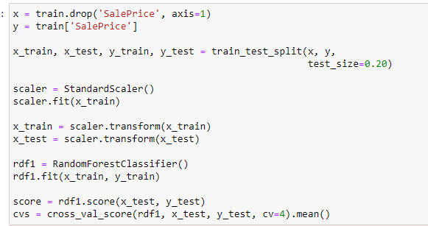
RandomForestClassifier

Slide 55
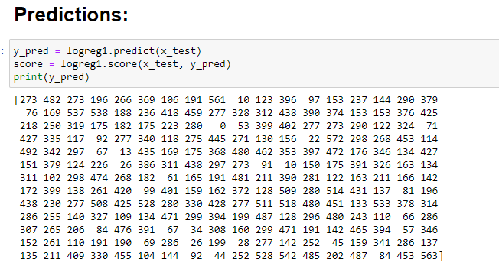
Prediction of model1 (LogisticRegression)

Slide 56
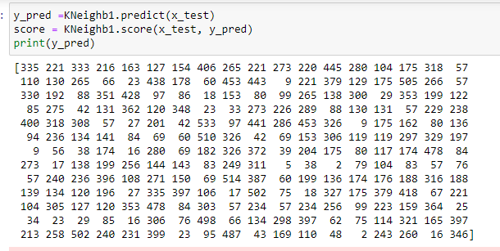
Prediction of model2 (KNeighborsClassifier)

Slide 57
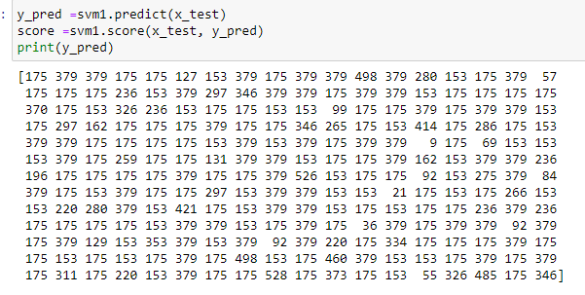
Prediction of model3(SVM)

Slide 58
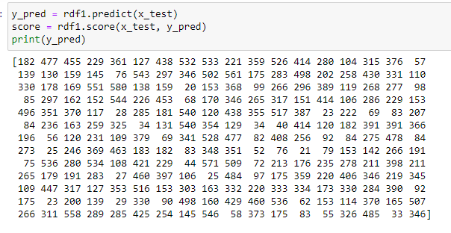
Prediction of model4
(RandomForestClassifier)

Slide 59
Conclusion of all the visualizations:
Correlation conclusion-We can see that the features OverallQual, GarageArea and YearBuilt are closely correlated with the sale price.
That means these features play an important role in determining the SalePrice of a house. Similarly a lot of
inferences can be made just by looking at the heatmap but we're not going to go through each one of them.
If you don't know what a heatmap is and wish to learn.

Slide 60
Conclusion:
Scatterplot:
1) we can see the in the plot darker spots in 2000 (200-600).
2) we can see lines clear at point 4,6,8 and a few other ones.
3) We can see there are a number of "horizontal lines" in the plot: one clear one at point 4 ,one at
5 and a few other ones.
4) we can see in the plot clear line at point 8, and lightly at 6 and a few other ones.

Slide 61

Conclusion of all the visualization :
Lineplot1
Lineplot2
You might have noticed a significant increase in SalePrices just after the start of the 21st century,
which is pretty interesting. What's even more surprising is the late 1800s saw phenomenal increase in
SalePrices but dropping way below even before the end of that century.
We can see that the SalePrices increase rapidly with houses with better overall quality which is pretty reasonable.

Slide 62
Conclusion
Distplot
Distplot:
It's clear that most of the houses, about 80% are sold for a price in the region on 100,000 and 200,000 dollars. Looks like there are a lot of houses sold in the mid 100,000s which makes up most of the data.
It is clear that the selling prices for Sale types 2 and 6 are significantly higher than the others.

Slide 63
(Scope for Future Work)House price predictions for the next five years
House prices have been skyrocketing since the pandemic, but as the cost of living crisis continues to rise, what are house price predictions for the next five years?
House price predictions for 2023/2024
Rising interest rates are the main reason behind a predicted slow down in the housing market in 2023 and 2024. But experts differ in their opinions of how quickly the Bank of England will continue to increase the base rate, which was raised to 3% in November.
Estate agents Savills expects the base rate to rise to 4% in early 2023 and remain there until mid-2024 before starting to fall back. Capital Economics predicts the base rate to rise to 5% next year before dropping to 3.25% in 2024.
It’s generally agreed, however, that mortgage rates of around 5% will remain the norm for the next two years.
As interest rates remain higher fewer buyers can afford to purchase a home so house prices will fall. Sellers are also reluctant to sell when house prices are falling which will add to the slowdown in the housing market.

Slide 64
House price predictions for the next five years
Table:
2023 2024 Output:
1)Savills- - 10% 1%
2)Knight Frank -5% 5%
3)CapitalEconomics* -8.5% 2.5%
House price predictions for 2025, 2026 and 2027:
The decline in house prices is expected to be short-lived.
Lucian Cook, head of residential research at Savills, says: 'There are several factors that will protect the housing market from the risk of a bigger downturn like we saw after the financial crisis.
……….END of the PROJECT_HOUSING………
'Until August this year when the rules changed, borrowers have had their affordability heavily stress-tested by their mortgage lender which has protected them from becoming over-indebted. This, combined with relatively modest unemployment expectations and signs that lenders are looking to work with existing borrowers to help them manage their household finances, should limit the amount of repossessed homes, from hitting the market next year.'
Savills says it expects to see house price growth of 1% in 2024 and a larger rebound of 7% in 2026 if mortgage lenders cut rates over the next 12 months and the base rate declines from mid-2024 as inflation falls.
Table:
2025 2026 2027 OUTPUT:
Savills 3.5% 7% 5.5%
Knight Frank 2% 4% n/a
Capital Economics* 2% n/a n/a

